Slide 1
Presidents Quarterly Roundtable
November 9, 2023

Slide 2
Agenda
Membership
Board Ballot Timeline & Nominees
Segment Leaders Orientation
Board /Council Update from November 3-5
New Advisory Committee
Meetings Model Committee Update
Meetings Updates
Center for Advancing Accounting Education Updates
IT/Marketing Update
Finance Updates
Publications Updates
Foundation Updates
Open Conversation/Questions

Slide 3
Membership
BILL PERIOD | Selected Date | Membership Counts
2023/24 | AS OF 11/8/2023 | 5535
2022/23 | AS OF 11/8/2022 | 5510
2022/23 | EOMY | 6271
2021/22 | EOMY | 6601
2020/21 | EOMY | 6217
2019/20 | EOMY | 7154

Slide 4
Section Membership
BILL PERIOD | Selected Date | Membership Counts
2023/24 | AS OF 11/8/2023 | 7286
2022/23 | AS OF 11/8/2022 | 7548
2022/23 | EOMY | 8249
2021/22 | EOMY | 8643
2020/21 | EOMY | 8255
2019/20 | EOMY | 9157

Slide 5
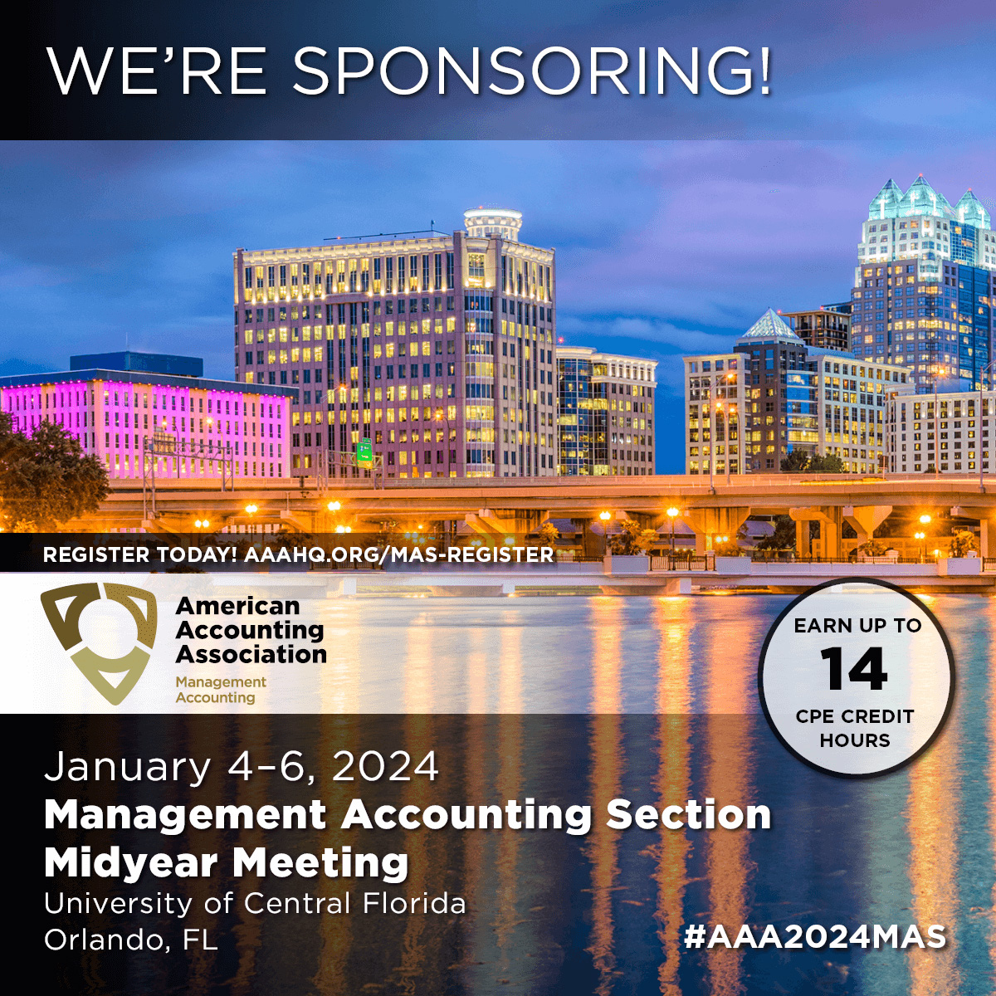
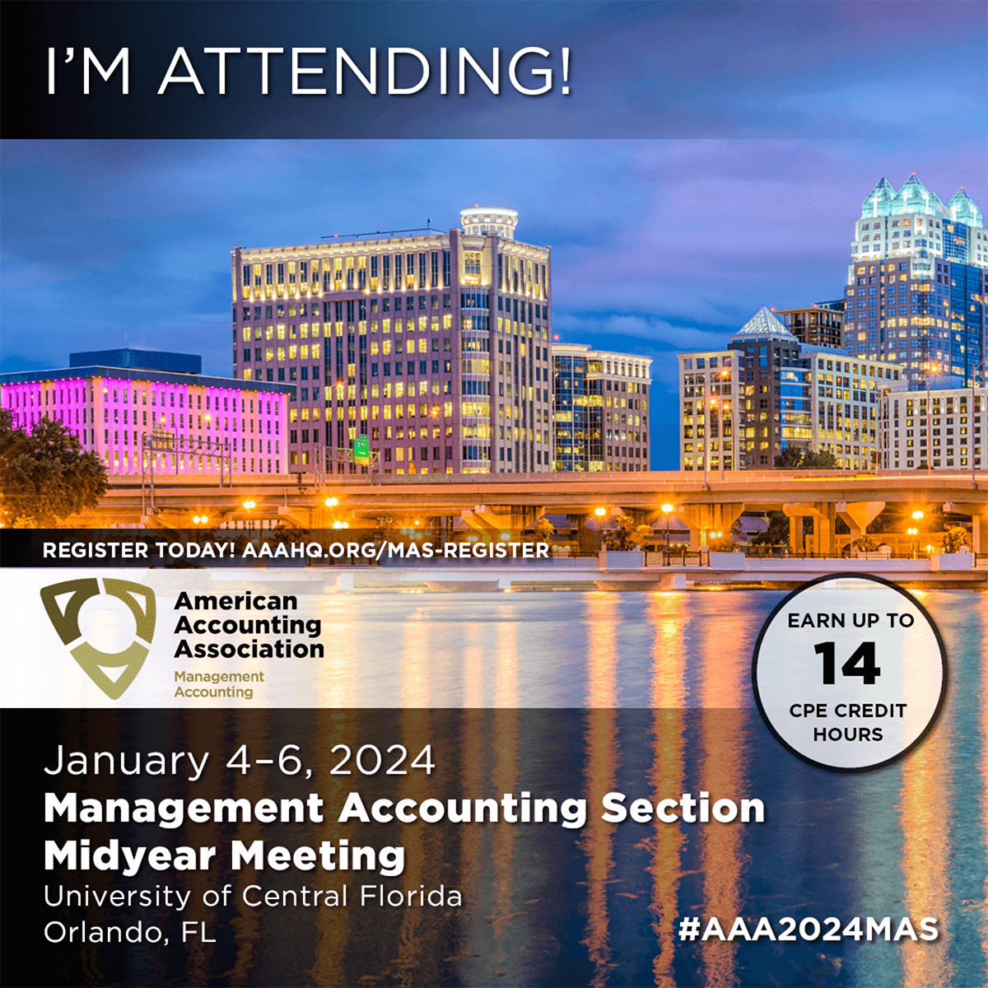

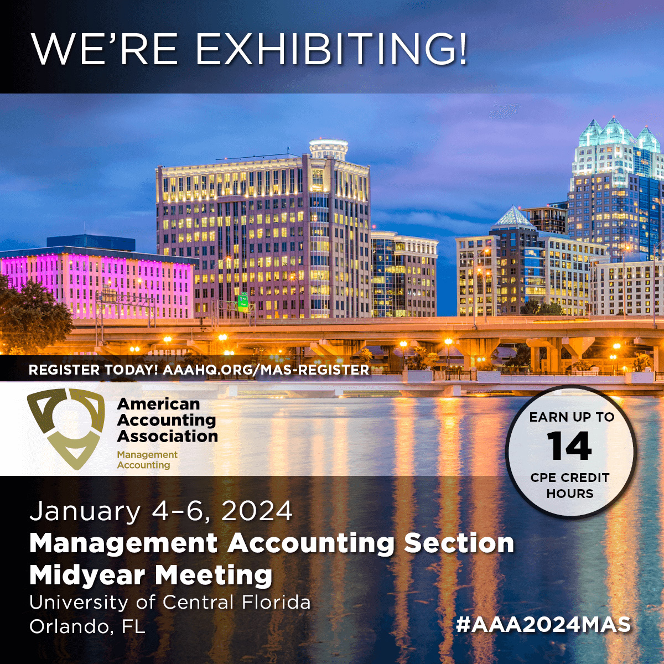

Slide 6
2024 Board of Directors Election Timeline
Remaining Steps in the Election Cycle
October 24 - AAA Nominations Committee met to choose the slate for the President-Elect and Vice President-Research & Publications.
November 4 - Council Ballot Committee met to choose the slate for Director-Focusing on Segments.
Today, November 9 - The slate for the Board of Directors officers will be announced and posted online.
December - “Get to Know the 2024-2025 Candidates” information will be posted online, with notice included on the AAA Website and in mass-emails.
On or about January 17, 2024 - Ballot opens for online voting on our website with notice included on the AAA Website and in mass-emails. The ballot is open for at least 30 days.

Slide 7
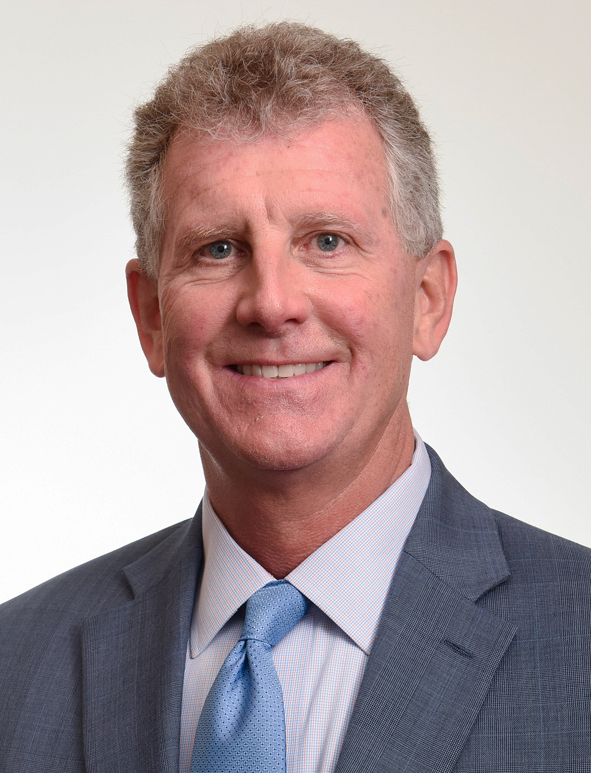
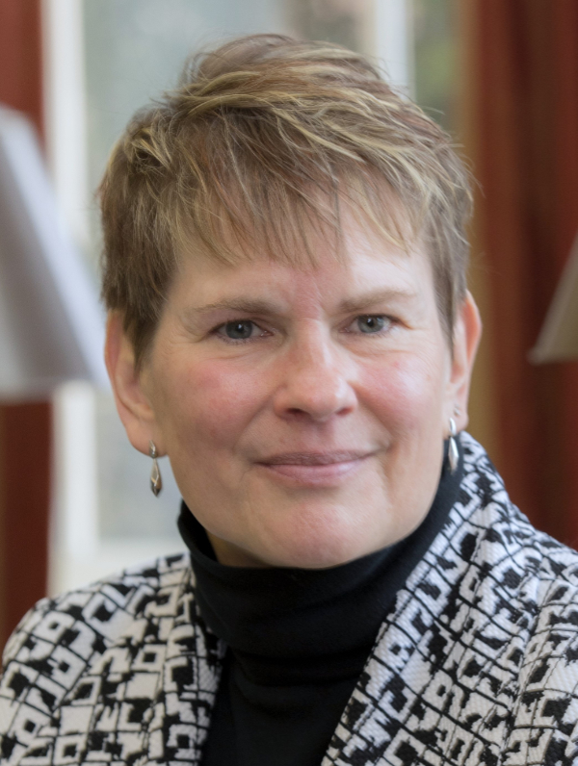
Nominees for President-Elect
Mark S. Beasley
North Carolina State University
Anne M. Farrell
University of Miami

Slide 8
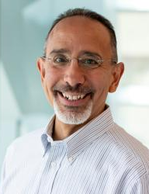
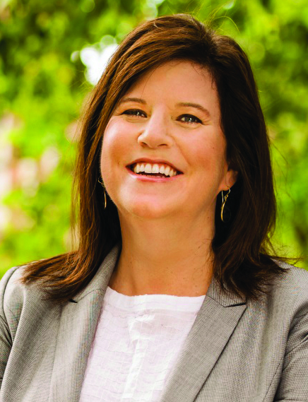
Nominees for Vice-President Research & Publications
Christopher P. Agoglia
University of Massachusetts
Amherst
Jacqueline S. Hammersley
The University of Georgia

Slide 9
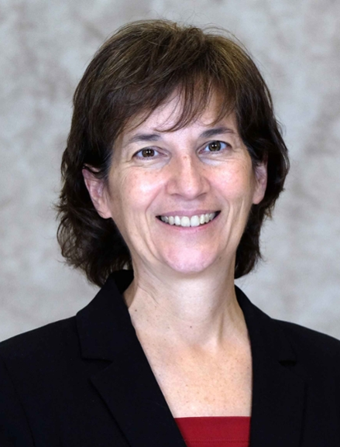
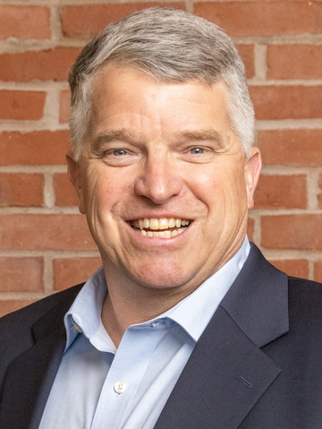
Nominees for Director-Focusing on Segments
Jennifer Reynolds-Moehrle
University of Missouri-St Louis
Jay C. Thibodeau
Bentley University

Slide 10
Board & Council Updates (11/3-5/2023)
AAA Building
Meetings Model Committee (Tim to discuss)
Council nominated ballot for Director Focusing on Segments
Regions

Slide 11
2023-2024 Section Advisory Committee
Name / Affiliation | Term Length | Term Expires
Chair, Diana Falsetta, University of Miami | 2 | 08/2025
Deniz Appelbaum, Montclair State University | 2 | 08/2025
Brian McAllister, University of Colorado-Colorado Springs | 2 | 08/2025
Kathy Rupar-Wang, Georgia Institute of Technology | 2 | 08/2025
Ann Dzuranin, Northern Illinois University | 3 | 08/2026
Stephannie Larocque, University of Notre Dame | 3 | 08/2026
Dick Riley, West Virginia University | 3 | 08/2026
Gia Chevis, Baylor University | 4 | 08/2027
Yvette Lazdowski, University of New Hampshire at Manchester | 4 | 08/2027
Scott Vandervelde, The University of North Carolina-Charlotte | 4 | 08/2027
Board of Directors Liaison, Mark Dawkins, University of North Florida | 1 | 08/2024
Liaison to AAA Council, Bambi Hora, University of Central Oklahoma | 3 | 08/2026

Slide 12
Meetings Model Committee Update

Slide 13
Background on Original Meetings Model Task Force
Formed in Feb. 2020
Charge: Assist the Board of Directors in developing one or more meeting models that, when combined, maximize the value of meetings to our members while minimizing financial risk

Slide 14
Meetings Model Committee
Formed in Fall 2021
Membership designed to represent the varied interests of the Segments
Current Membership
Veronica Paz (chair), Regions Mary Ellen Carter, FARS
Stephani Mason, Diversity Cathy Scott, TLC
Scott Bronson, Auditing Sean Hillison, ABO
Mina Pizzini, MAS Lynn Jones, ATA
Alyssa Ong, Forensic
Yvonne Hinson, AAA CEO
Erlinda Jones, (ex officio), Senior Director, Meetings and Programs
Tim Rupert, (Board of Directors Liaison), Northeastern University

Slide 15
Work of the Meetings Model Committee
Focus: Significant indirect costs that are not currently being allocated
Estimated scope of costs for sections: $823,000 FY 2023
Currently, these costs are being covered by the general fund, meaning primarily membership dues and other funding sources (aggregator contract funding).
Charge: Develop a model to allocate the costs among the section meetings so that the meetings are self-sustaining

Slide 16
More about the $823K
Part of the AAA Budget Process annually; approved by Board and part of audit process
What makes up this number?
Meetings, Membership, Finance, IT Staff salary, benefits, and retirement
Supplies
Registration System
Insurance
AAA staff working to increase efficiency and reduce the $823K amount

Slide 17
Implementation: Models
Last Year’s Committee worked to develop several different possible models for initial feedback from AAA Council. Possible factors included number of days of meeting, attendees, number of sessions
Presented to Council in April 2023
This Year’s Committee met to finalize our recommendation for the allocation model

Slide 18
Implementation: Models
Allocating costs over 17 meetings that are sponsored by the AAA sections
Considered four different models with different cost drivers
Ran outcome for each meeting and compared across models
Great deal of similarity in outcomes across models (R² around 0.7)

Slide 19
Implementation: Models
Recommendation:
Model based on Days + Attendees with a fixed amount
Rationale: Wanted to try to maintain simplicity but also recognize key differences in meeting structure.
Committee felt the two cost drivers (days and attendees) best achieved that

Slide 20
Implementation: Next Steps
Committee working on confirming the data and analysis
Will meet with representatives of sections to review model results for section meetings
Phased Implementation (4 years)
Current Year—0% application
Second year (next year)—33% application
Third year—67% application
Fourth year—100% application

Slide 21
Meetings Update
Annual Meeting 2024
Attendee Interactive Submission System
2023-2024 Meetings
LinkedIn Section Meeting Marketing

Slide 22
The Inclusive Classroom Certificate
Eight Modules are Available on our new Learning Management System (LMS)
https://lms.aaahq.org/
A Certificate will be offered when 10 modules are complete.
The Certificate will be offered free to members and non-members.

Slide 23
Webinar Series
weARE Webinars: Scheduling in March
Pipeline Series
Results of the Future Accountant Stakeholder Symposium
Wednesday, 11/15, 2:00 pm – 3:30 pm
Technology Series
A series on Python will be offered starting in January

Slide 24
Sustainability, ESG and Accounting Conference
February 16th and 17th, 2024 in Washington, DC
Confirmed Speakers:
Rudi Bless, Chief Accounting Officer, Bank of America
Candace H. Duncan, Board Member, Discover Financial Services and Teleflex
Nigel J. James, Senior Associate Chief Accountant, U.S. Securities and Exchange Commission
Thomas J. Kim, Partner, Gibson, Dunn & Crutcher
Elizabeth Seeger, Board Member, ISSB

Slide 25
Information Technology/Marketing Update
Marketing Update
Schifino/Lee and Cactus Communications Marketing Firms
Section Membership Reporting (PowerBI)
Webmaster training

Slide 26
Finance Update
Fiscal year end audit is complete and there were no findings or adjustments.
1st Quarter financials will be distributed within a week along with the new Treasurer’s Guidebook.
Please read the Treasurer’s Guidebook and watch the video. Instructions on how to review your financials and important updates are covered. Everything is located on the Segment Leaders webpage. https://aaahq.org/SegmentLeaders

Slide 27
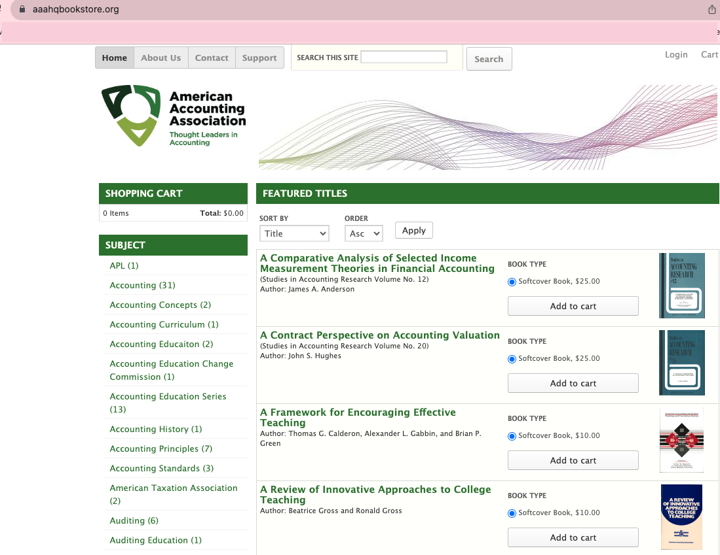
Publications Update
AAA Bookstore now available at https://aaahqbookstore.org/
E-commerce shopping experience
Discount code still active! 10% off entire purchase through November 15, 2023. Just use the coupon code AAA10 at checkout.
More improvements in peer review: aligning article types and submission items.
Quality Assurance Checklist 2.0 coming soon.
Forthcoming: Publications Ethics policies for the use of AI-generative tools.

Slide 28

Foundation Update
Announced at 2023 AAA Annual Meeting
Mission: To ensure a vibrant and thriving Accounting Profession
5 Pillars
Strategic Planning 11/6-11/7
Funding – Not cannibalizing AAA or Section Funding

Slide 29
Questions?

Slide 30
Thank you! Yvonne.Hinson@AAAHQ.ORG

